Slide 1
Database Connection and messaging System.

Slide 2
Database Plan for semester one.
Fully functioning connectivity.
User Accounts.
Messaging System.

Slide 3
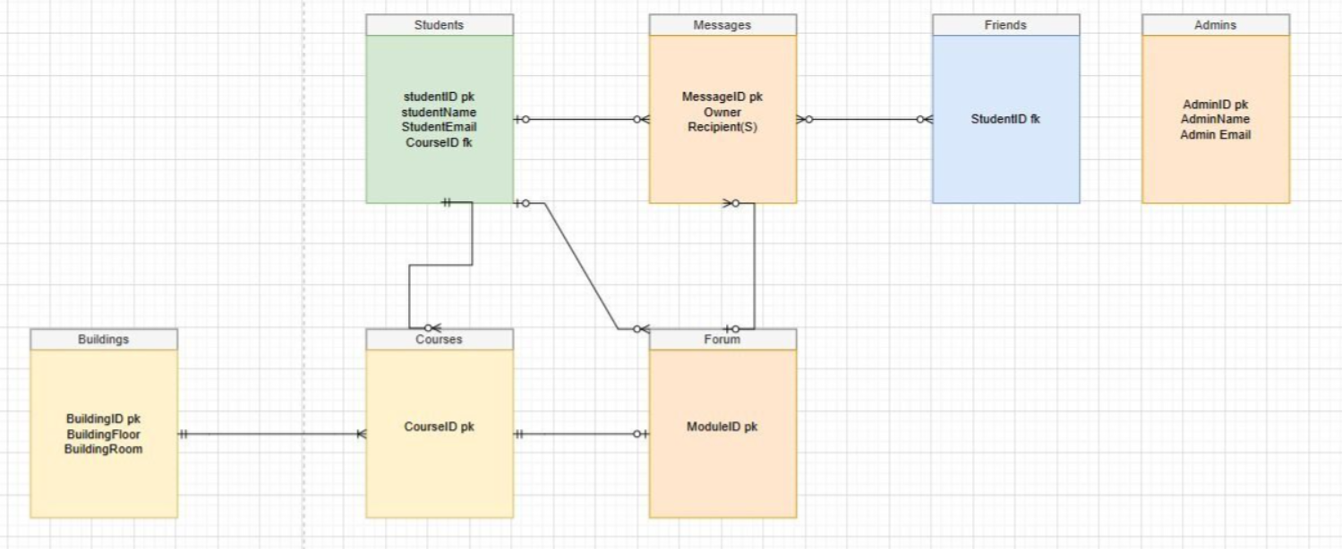
Database Plan

Slide 4
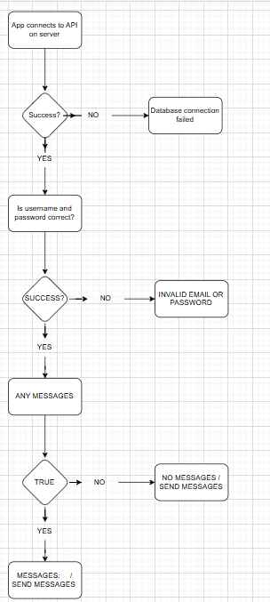
Flow Chart for semester one plan.

